Slide 1



SIMILARITY ANALYZER
ARTIFICIAL INTELLIGENCE LAB PROJECT
Group 1 : TEAM UNO
Group Members:
Kaifa Tabassum - 2018331037
Debapriyo Dhar - 2018331065
Ananna Datta Dristy - 2018331049
Kawchar Husain - 2018331085
Omar Sultan - 2018331077

Slide 2


Motivation Behind Project
Similarity analyzer is used to measure the similarity or relatedness between two or more items (such as documents, or text snippets). The purpose of using a similarity analyzer is to:
Find duplicates or near-duplicates in a large dataset.
Group similar items together for organization and analysis.
Compare and match items for recommendation and search purposes.

Slide 3

Why Use Similarity Analyzer?
The Internet has brought a vast source of resources to our fingertips. With so much content available, it’s sometimes hard to know when something has been plagiarized. Moreover, similarity analyzer is used in recommendation systems, finding relevance among documents and so on. From authors checking for their posts being stolen and posted elsewhere to checking for recommendations, similarity analyzer has become a must nowadays.

Slide 4
UNOCHECK
FREE
GUARANTEE
CHECKER
Analyze similarities among articles free of charge
100% guarantee for unique content in your research articles
Catch plagiarism from databases in the research field

Slide 5
Data Preparation
Data collection
Combining Datasets
Data cleaning
Abstract of research papers from various fields.
Combining several datasets to achieve better performance.
Eliminating duplicates, null values and dropping unnecessary columns.
Notes:
For training this project we have used some public datasets from Kaggle that consisting abstract of research papers from various fields like Computer Science, Machine Learning, Artificial Intelligence, Statistics, Physics etc. But there was one issue with the public datasets that either they were too small(5 to 8 thousand papers) to achieve a good performance or too big(around 1 million papers) to work within our personal device capacity. So we combined several datasets to solve this issue and finally worked with around 50000 papers. Before combining them data cleaning was performed on each of the individual datasets dropping duplicates and Null values and unnecessary attributes. We only worked with one attribute so further feature engineering was not needed.

Slide 6
Model Preprocessing
Stemming
Stemming is the process of reducing words to their root form in order to reduce the dimensionality of text data. This is useful in similarity checker as it helps to reduce the number of unique words in a document and make it easier to compare documents by ignoring variations in word form.
Tokenization
Tokenization is breaking down the text into individual words or phrases. By tokenizing text, the model can more effectively compare the content and structure of two documents, making it easier to identify their similarities.
Notes:
Stemming is the process of reducing words to their root form in order to reduce the dimensionality of text data. This is useful in similarity checker as it helps to reduce the number of unique words in a document and make it easier to compare documents by ignoring variations in word form. For example, words such as "running," "runner," and "ran" can be reduced to the root form "run," making it easier to compare them across different documents.
Tokenization is the process of breaking down text into individual words or phrases. Tokenization is used to convert text into a structured format that can be easily compared to other documents. This helps to identify similarities and differences between documents, and to find patterns that may indicate plagiarism. By tokenizing text, the model can more effectively compare the content and structure of two documents, making it easier to identify instances of plagiarism.
Vectorization converts text into a numerical representation, such as a bag-of-words or TF-IDF, so that machine learning algorithms can process it. We used it to convert documents into numerical vectors to compare and evaluate them for similarity. Then, similarity metrics are calculated between these vectors to determine the degree of similarity between the data. This allows for fast and efficient similarity computation between large amounts of data.

Slide 7
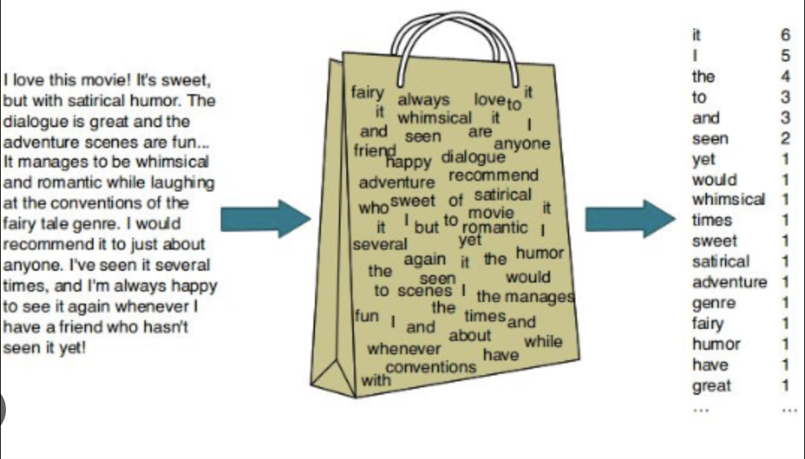
Vectorization
Vectorization converts text into a numerical representation, such as a bag-of-words or TF-IDF, so that machine learning algorithms can process it. We used it to convert documents into numerical vectors to compare and evaluate them for similarity. Then, similarity metrics are calculated between these vectors to determine the degree of similarity between the data. This allows for fast and efficient similarity computation between large amounts of data.
Fig: Bag of words by text vectorization
Notes:
Stemming is the process of reducing words to their root form in order to reduce the dimensionality of text data. This is useful in similarity checker as it helps to reduce the number of unique words in a document and make it easier to compare documents by ignoring variations in word form. For example, words such as "running," "runner," and "ran" can be reduced to the root form "run," making it easier to compare them across different documents.
Tokenization is the process of breaking down text into individual words or phrases. Tokenization is used to convert text into a structured format that can be easily compared to other documents. This helps to identify similarities and differences between documents, and to find patterns that may indicate plagiarism. By tokenizing text, the model can more effectively compare the content and structure of two documents, making it easier to identify instances of plagiarism.
Vectorization converts text into a numerical representation, such as a bag-of-words or TF-IDF, so that machine learning algorithms can process it. We used it to convert documents into numerical vectors to compare and evaluate them for similarity. Then, similarity metrics are calculated between these vectors to determine the degree of similarity between the data. This allows for fast and efficient similarity computation between large amounts of data.

Slide 8
Training Model
1
Transforming rephrased contents with the help of transformer based model
2
Finding the similarity score from cosine similarity value performed on transformed input document’s vector and precomputed vector index
3
Comparing the similarity score with our threshold in finding the percentage of similarities with the documents of out dataset

Slide 9
Transformer Model
One of the greatest challenges in similarity analyzing is content paraphrasing similarity. Rephrased contents can be difficult to capture by traditional tools because they do not take into consideration synonyms and antonyms of the overall context. Transfer based model is used in order to tackle the situation. A transfer based model is a neural network that learns context and thus meaning by tracking relationships in sequential data like the words in this sentence.
We have used 3 hidden layers of fully connected layers between encoder and decoder of the transformer.
Transformer
Encoder
Hidden Layer 1
Hidden Layer 2
Hidden Layer 3
Decoder
Fig: Inner working of a transformer

Slide 10
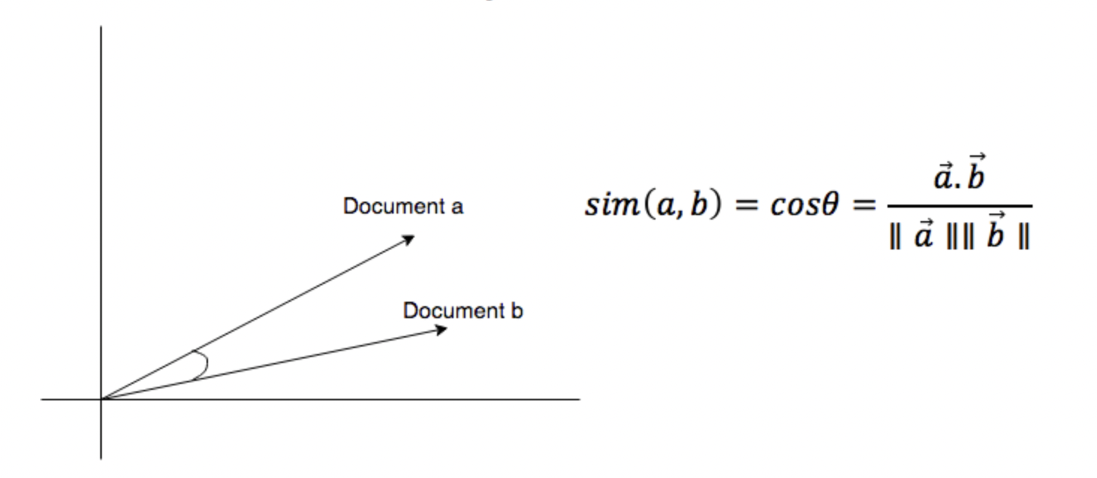
Cosine Similarity
Similarity is found when the incoming document’s vector is similar to one of the index vectors at a certain threshold level. But two vectors are similar when their magnitude and direction are similar. The cosine similarity measure operates entirely on the cosine principles where with the increase in distance the similarity of data points reduces.
Fig: Cosine similarity in finding text similarities

Slide 11
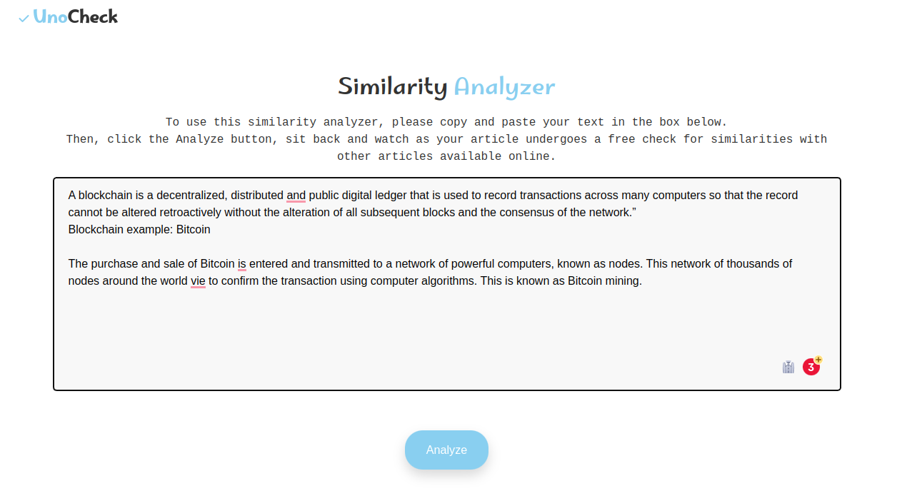
Application
Technology Stack - Flask, Python, HTML, CSS, JavaScript.
Used Pickle to dump and load the model.
So, We don’t need to train the model again & again.
We have turned our model into a python object.

Slide 12
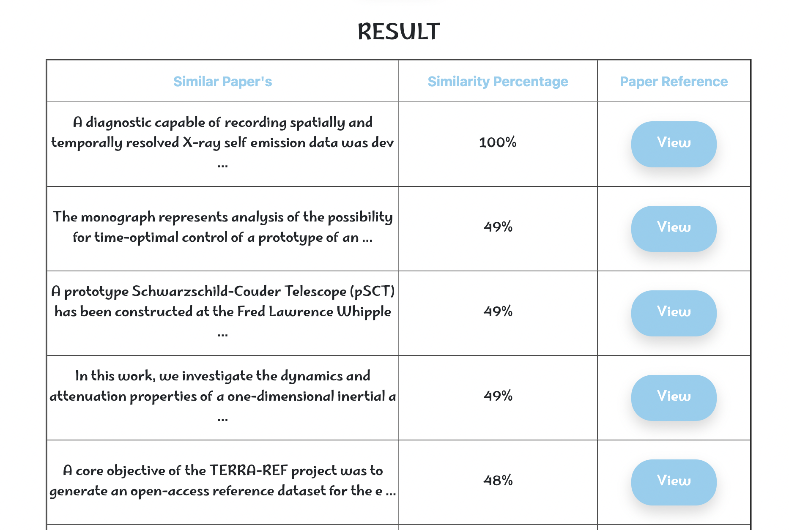
Simple to use.
Put your whole content altogether and analyze it.
3 Features mainly:
Abstract Header of the paper
Similarity Percentage
View button to see the full abstract.

Slide 13
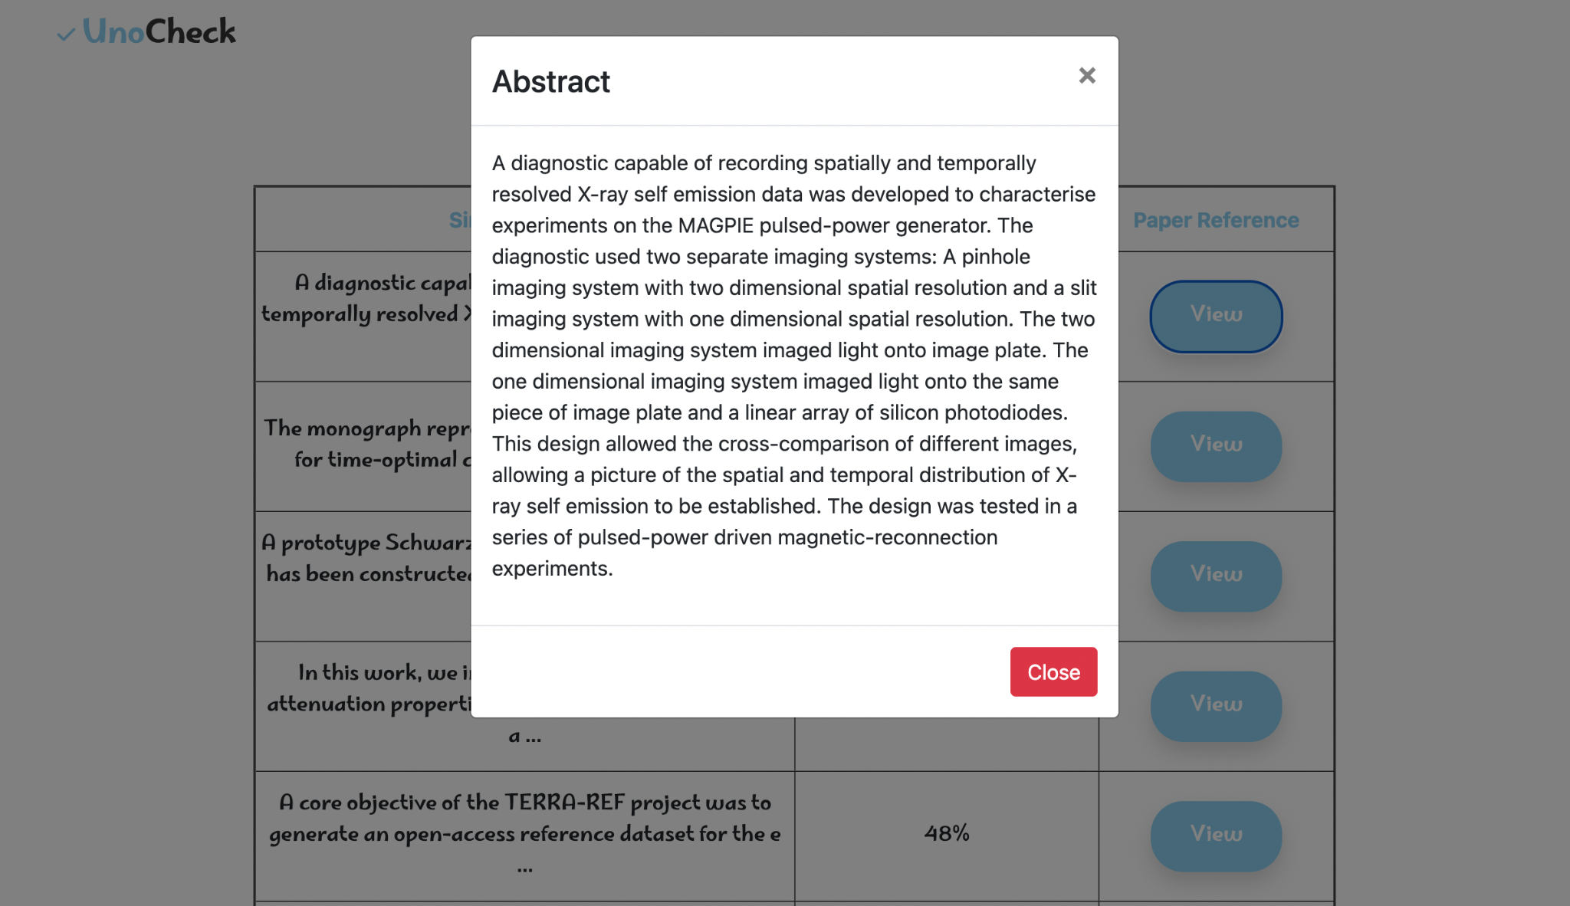
After pressing the View button, the abstract of the research paper will be shown

Slide 14
THANK YOU!

